Slide 1
Fungal Dead Wood Community in Raised Bogs (BogFunLigno)
A study will use complex approach (direct observation+ metagenomics)
Nina Filippova, Yugra State University, Khanty-Mansiysk, Russia
Naturally paludified area of a raised bog Mukhrino with dead wood canopy

Slide 2
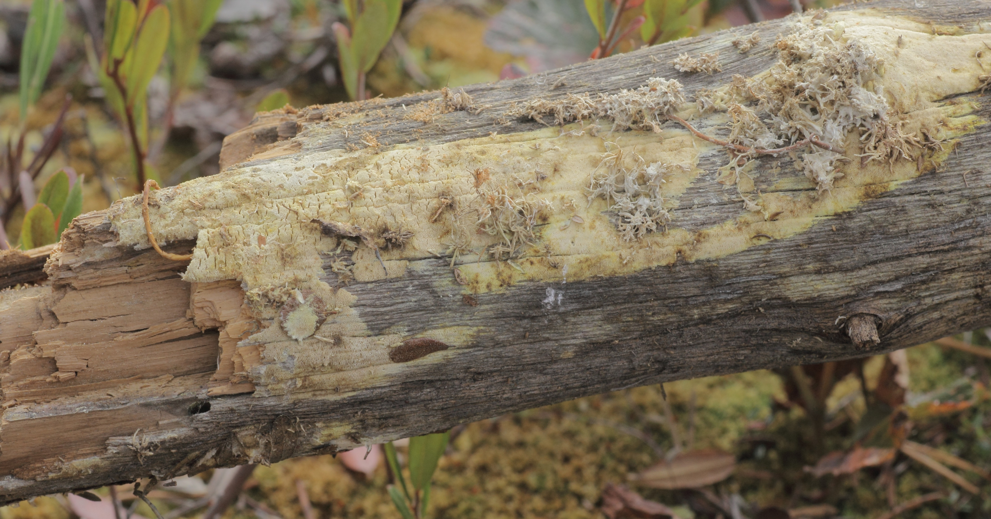
Dead Wood in raised bogs – rarely studied substrate, but interesting
Dwarf trees: Pinus sylvestris, Pinus sibirica (logs, stumps, buried in Sphagnum or standing-dead and weathered)
Dwarf-shrubs stems: Chamaedaphne calyculata, Ledum palustre, Betula nana, Andromeda polifolia
Peat – chemically close to wood substrate
Area of a raised bog Mukhrino with living wood canopy

Slide 3
Previous results
49 species of lignicolous fungi from five groups (corticioid, polyporoid, heterobasidiomycetous, agaricoid, clavarioid basidiomycetes, and discomycetes)
Two xerotolerant species were registered regularly on bog wood (Amyloporia xantha, Sistotremastrum suecicum)
Common species represented by several collections: Coniophora arida, Peniophorella praetermissa, Phlebiella pseudotsugae, Piloderma byssinum, and Dacrymyces stillatus.
Eight corticioid species were registered on peaty substrates adjoining wood surfaces, and two species were growing on living Sphagnum in absence of wood
Filippova, N.V., Zmitrovich, I.V., 2013b. Wood decay community of raised bogs in West Siberia. Environmental Dynamics and Global Climate Change 4, 1–16. https://doi.org/10.17816/edgcc411-16

Slide 4
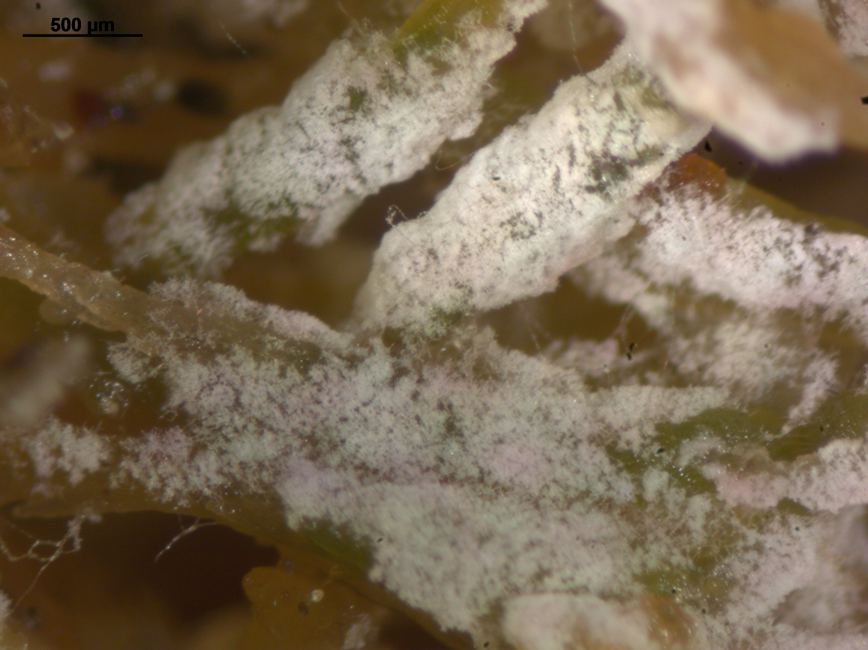
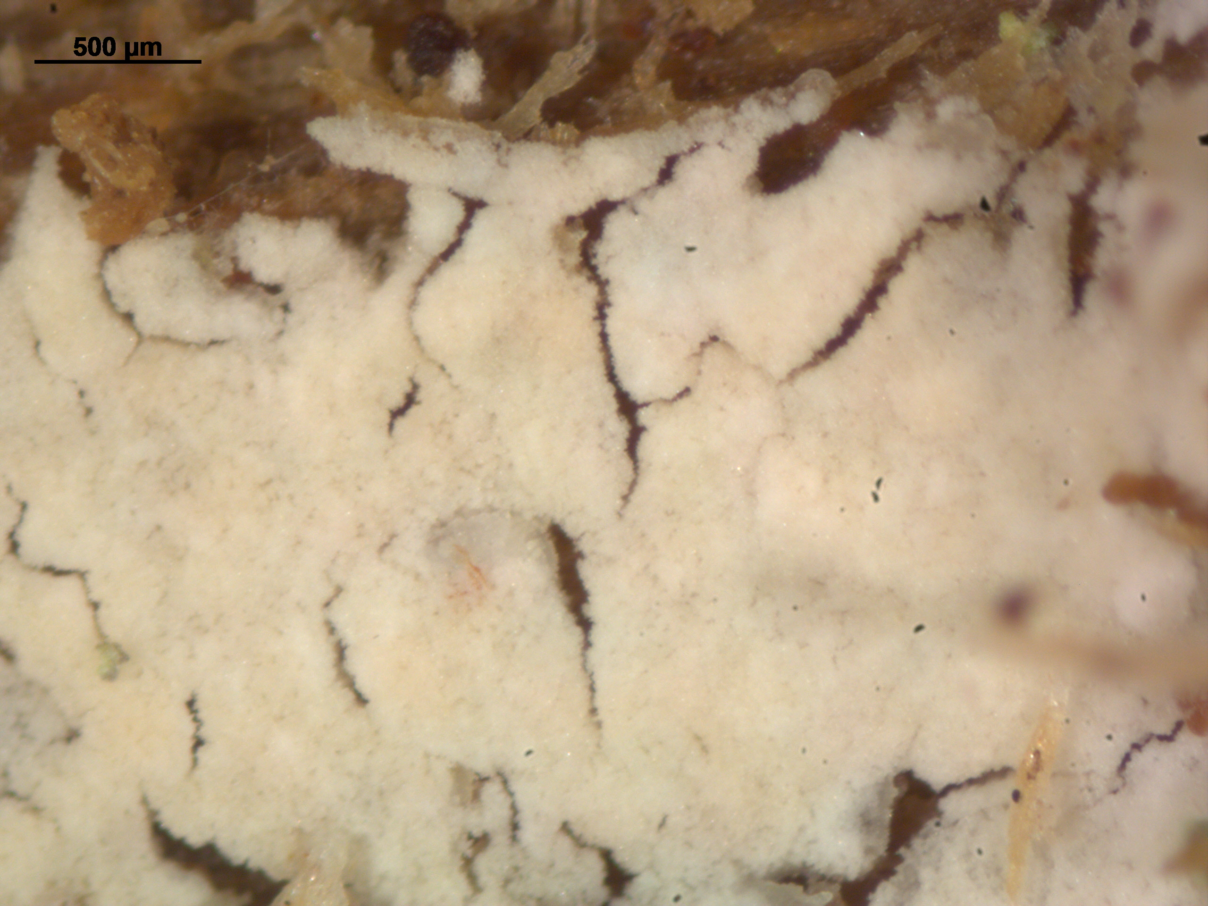
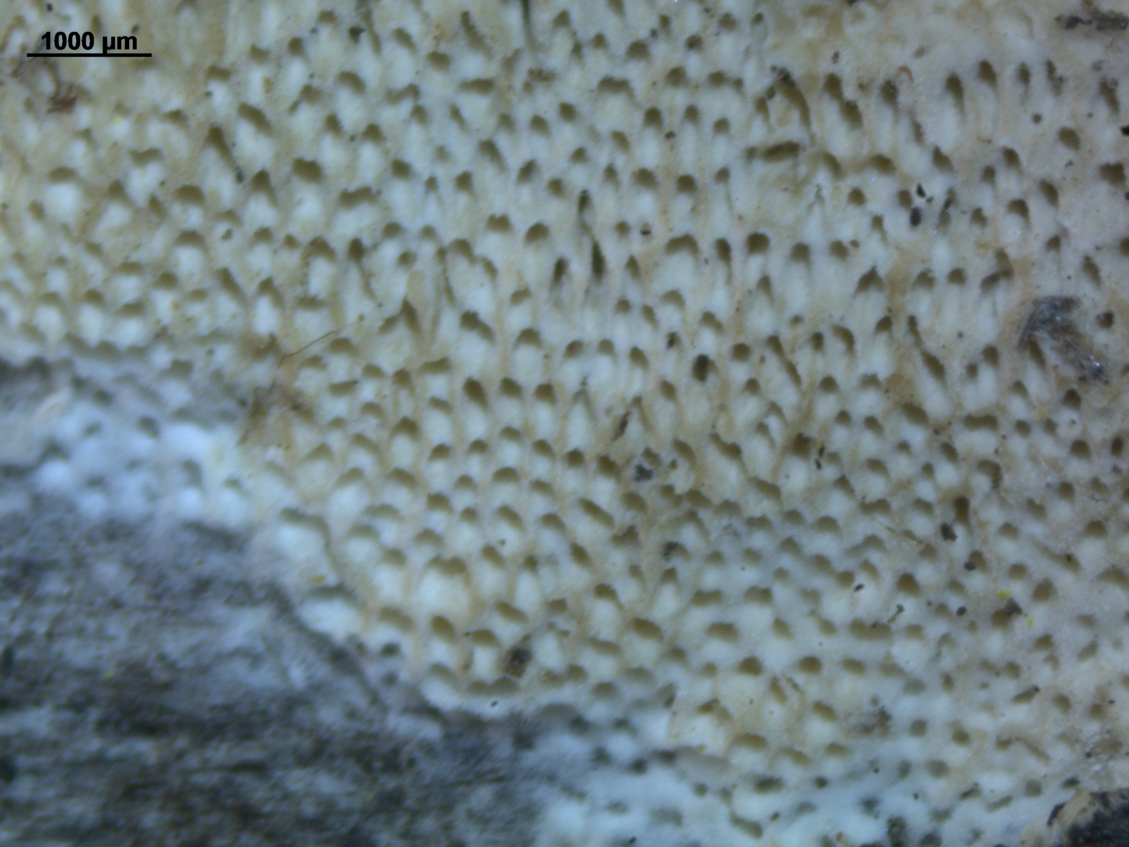
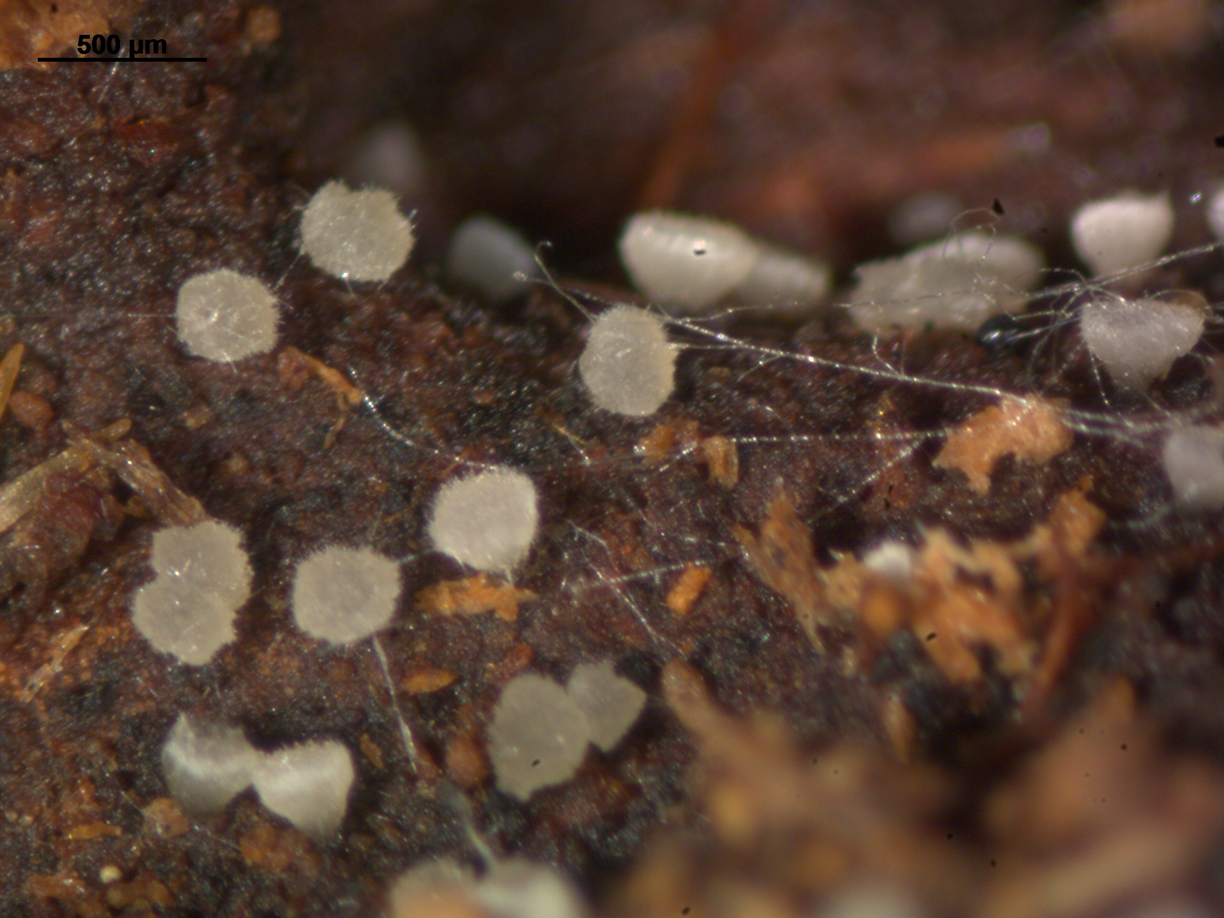
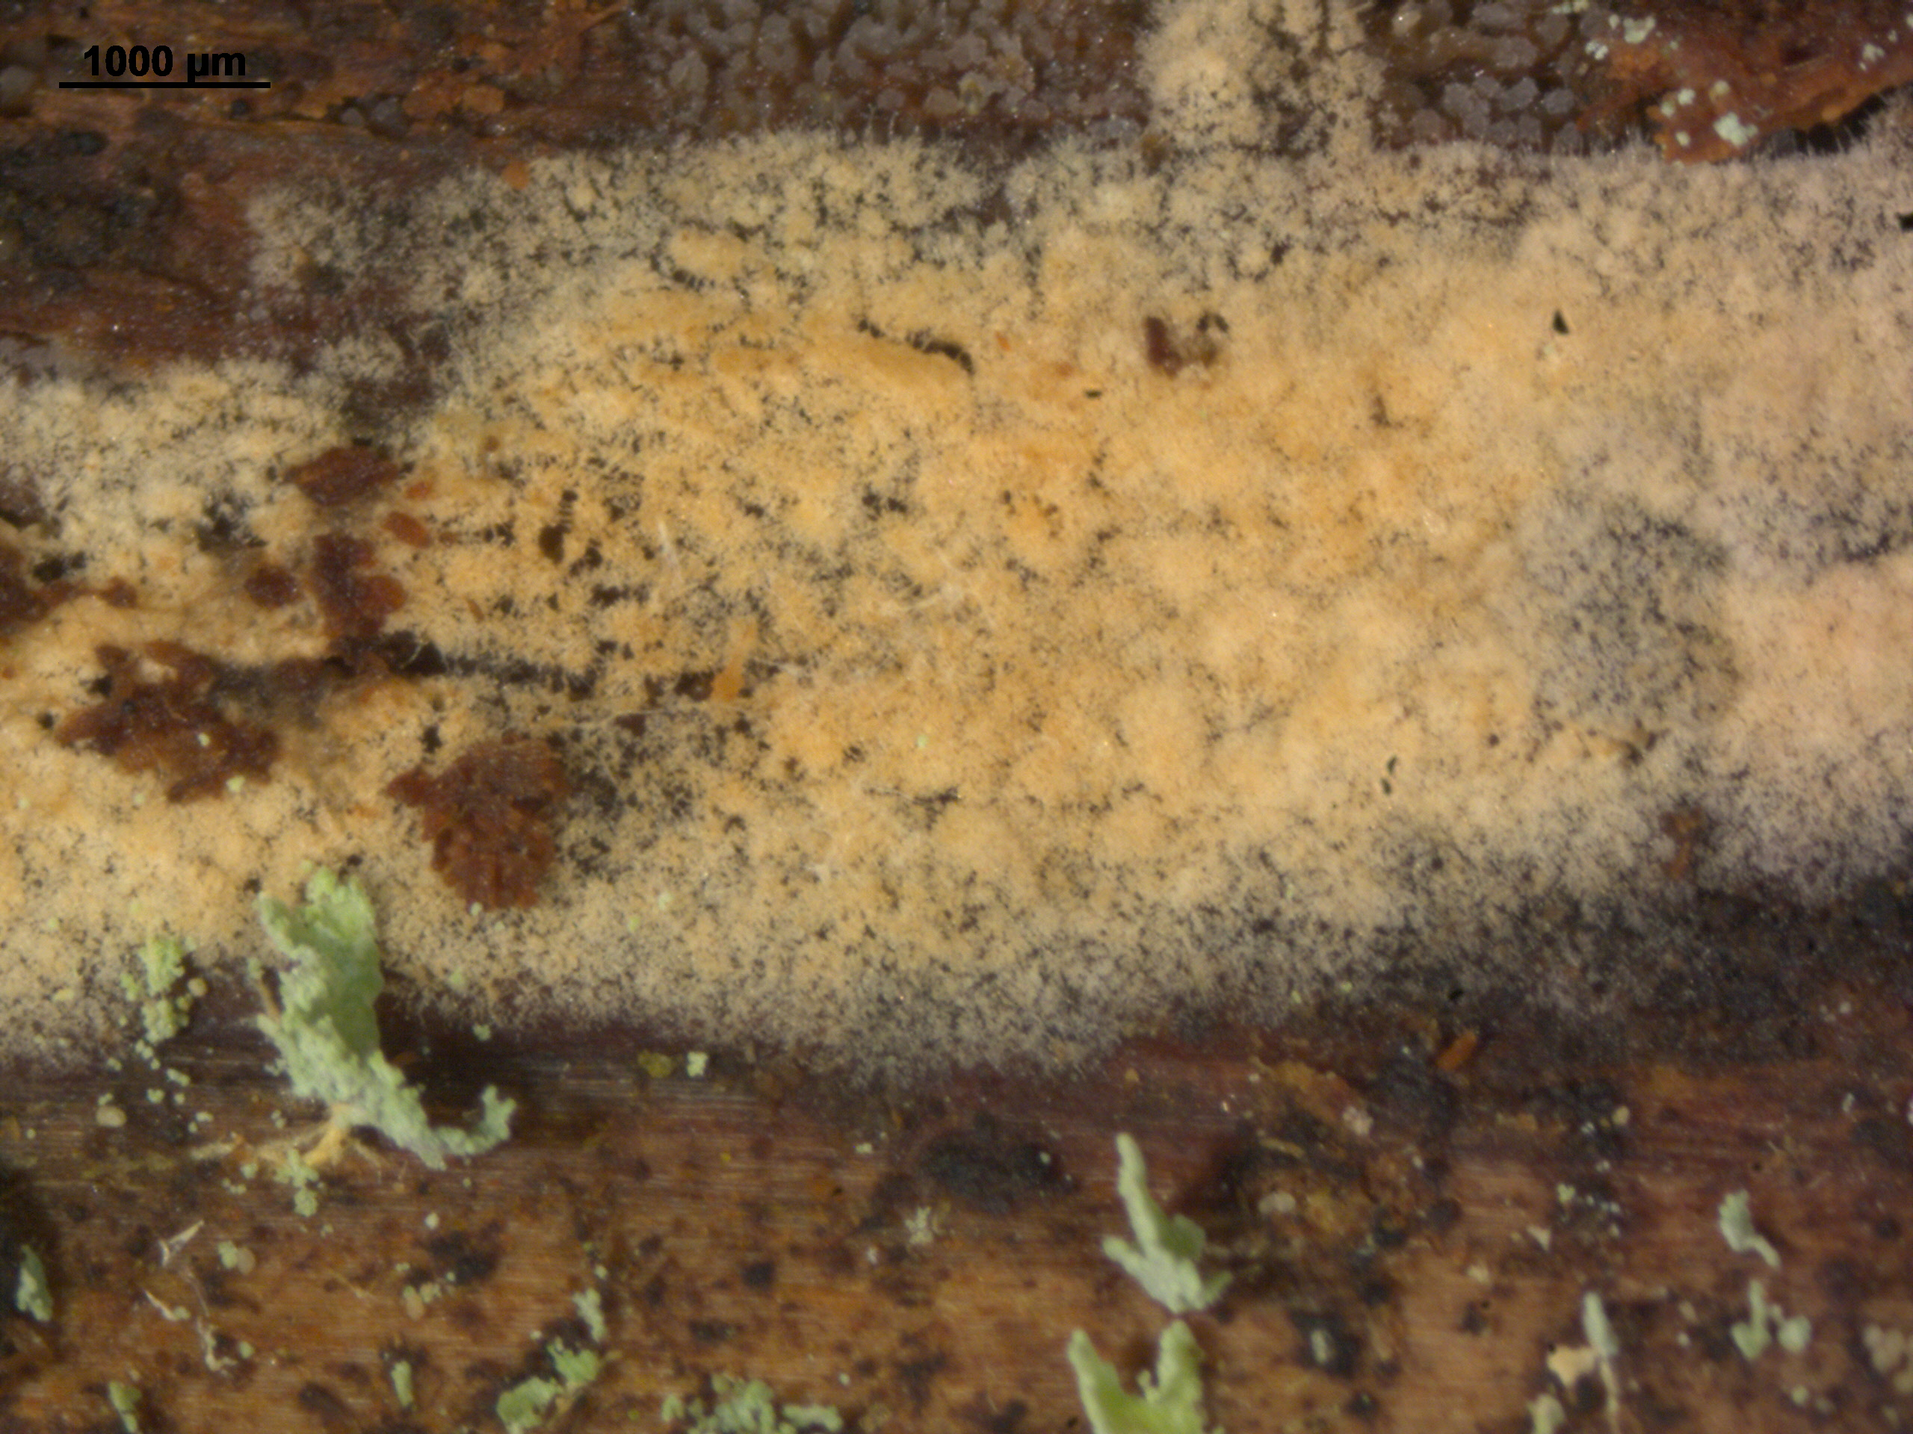
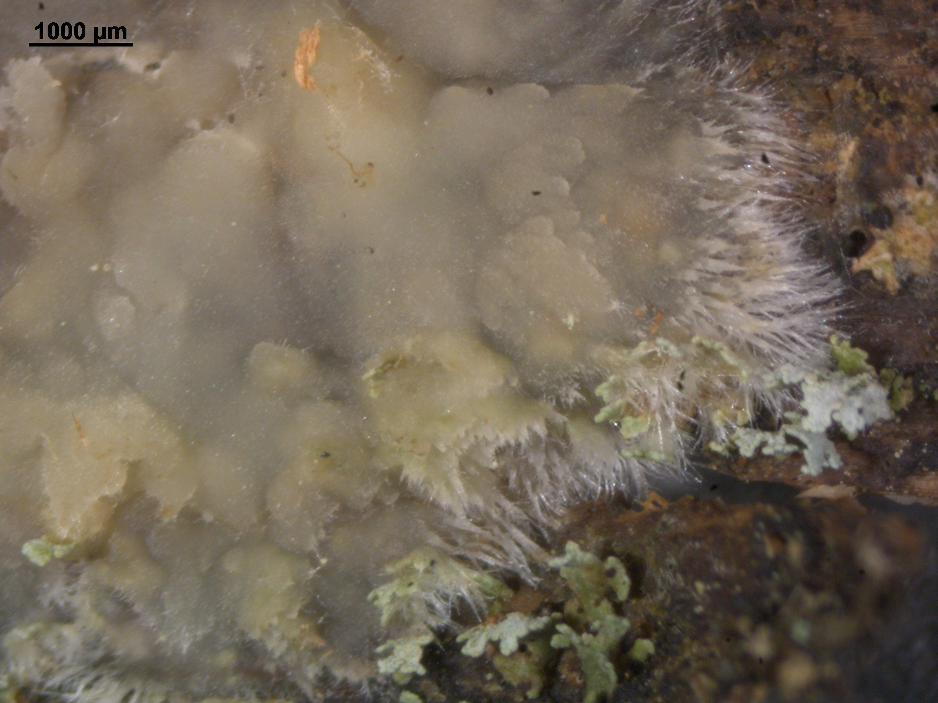
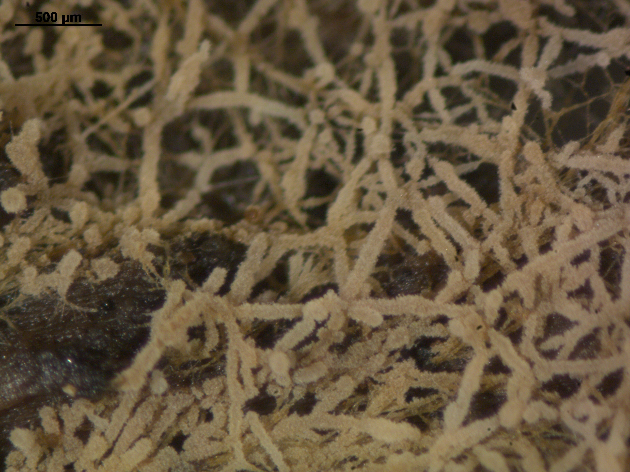
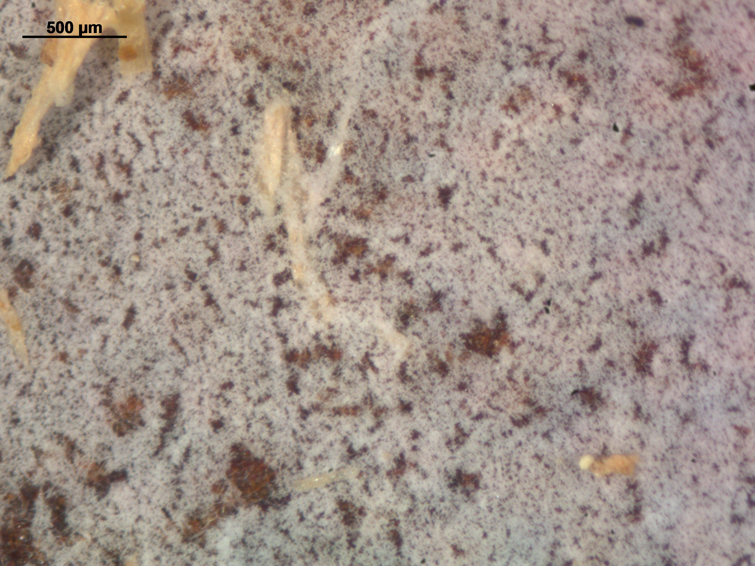
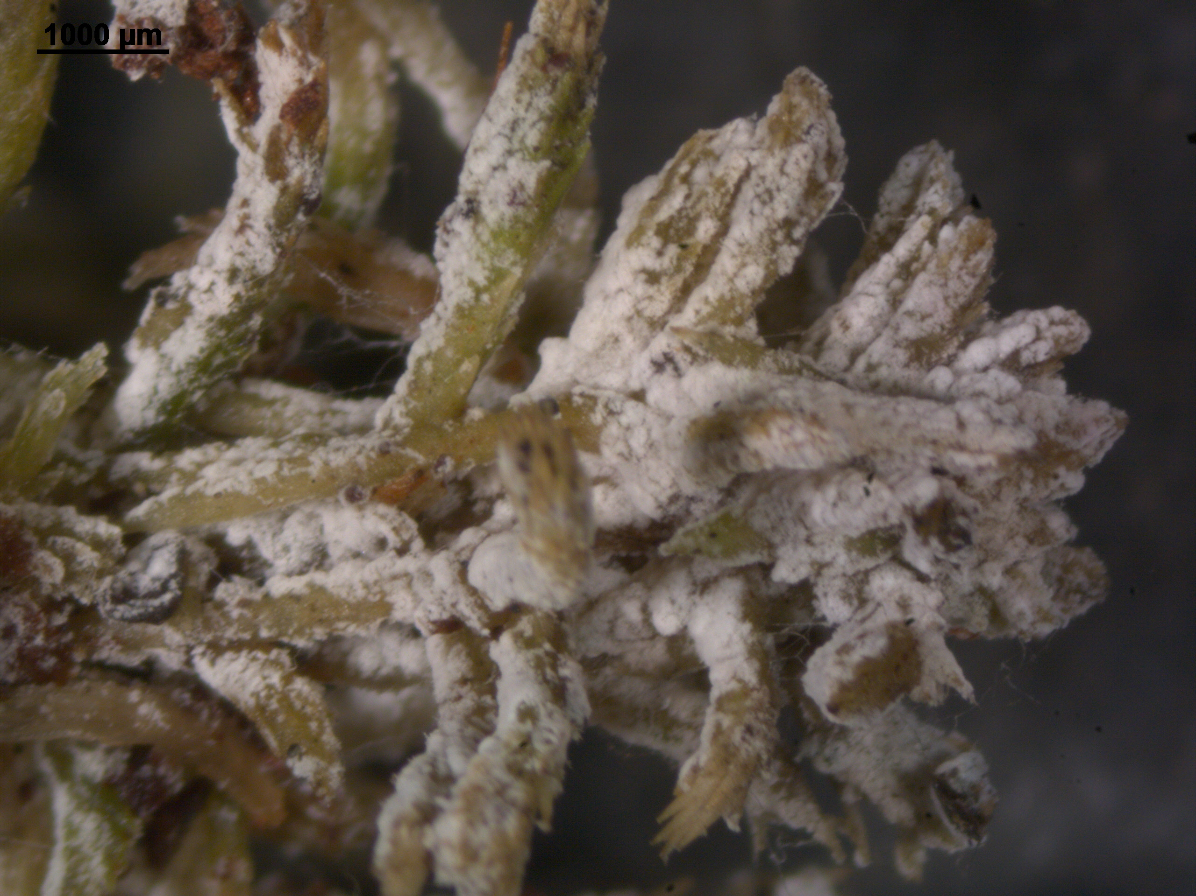

Slide 5
Mukhrino field station research infrastructure
Access the station for field work in 2022
Through INTERACT Transnational Access call

